Slide 1

Connect 4 Game Development Presentation
MEMBERS: FUAD Baghirzade(201ADB102) KAMRAN IBRAHIMOV(211ADB064)

Slide 2
About the Project
Objective: Develop a digital version of the classic strategy game Connect 4.
Description: Two-player game where players take turns dropping colored discs into a grid aiming to connect four discs in a row vertically, horizontally, or diagonally.

Slide 3
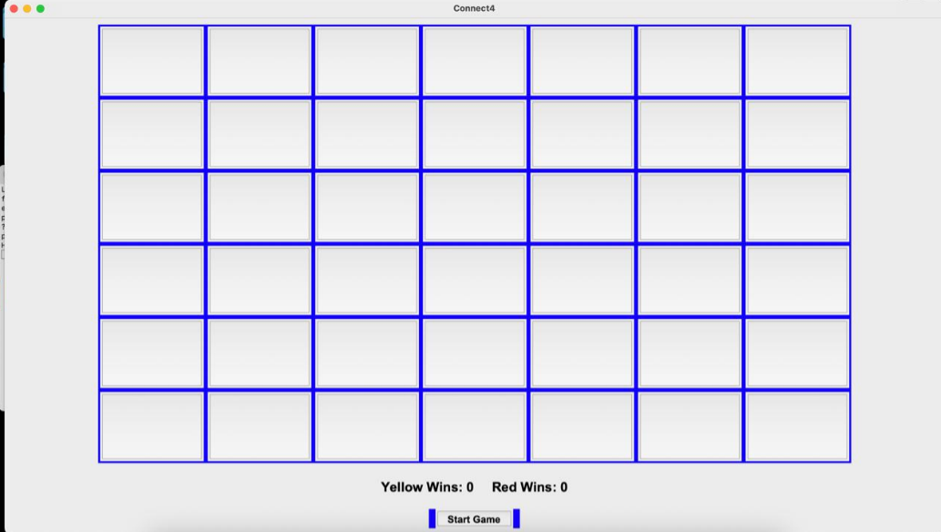
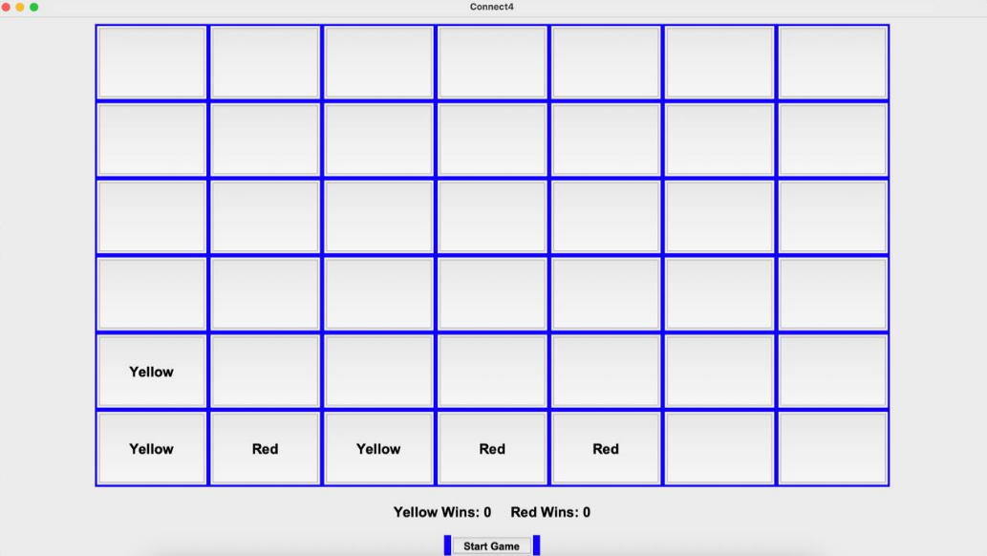
Screenshots of the game
Beginning of the game
Game process

Slide 4
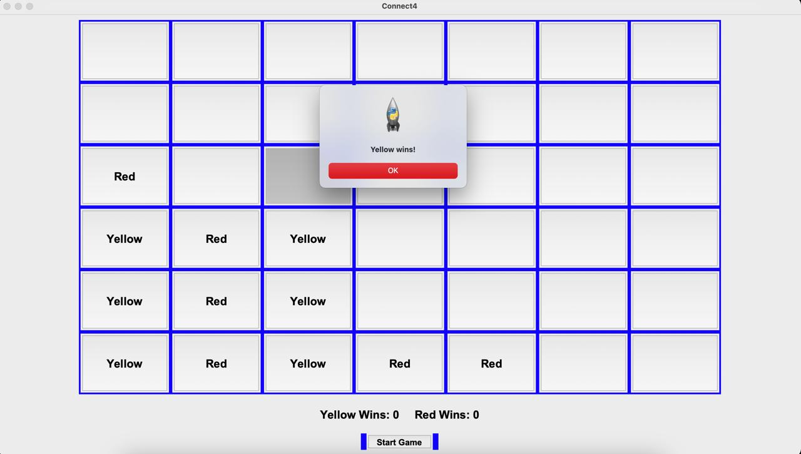
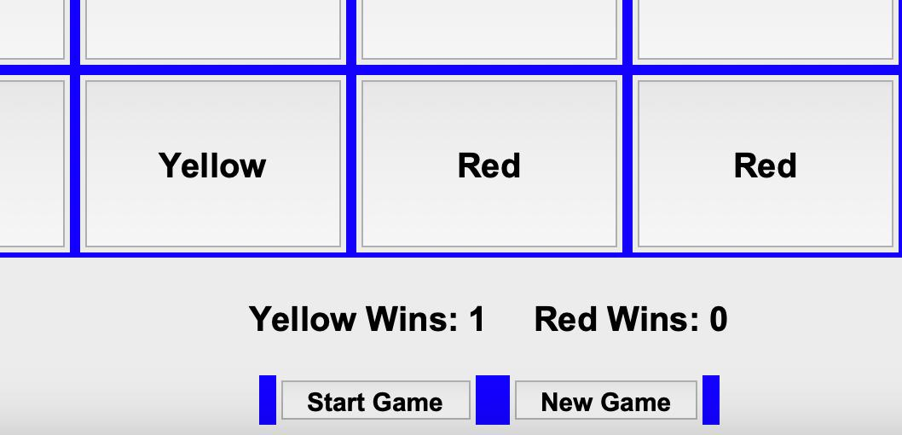
Game end
Scoreboard after win

Slide 5

Software requirements
Functional Requirements:
1.Grid board with 6 rows and 7 columns.
2.21 red discs and 21 yellow discs.
3.Support for desktop and mobile platforms.
4.Different levels of difficulty.
5.Features such as leaderboard and tutorial mode.
Non-Functional Requirements: 1.User-friendly UI.
2.Clarity and responsiveness in gameplay. 3.Providing a music after winning .

Slide 6
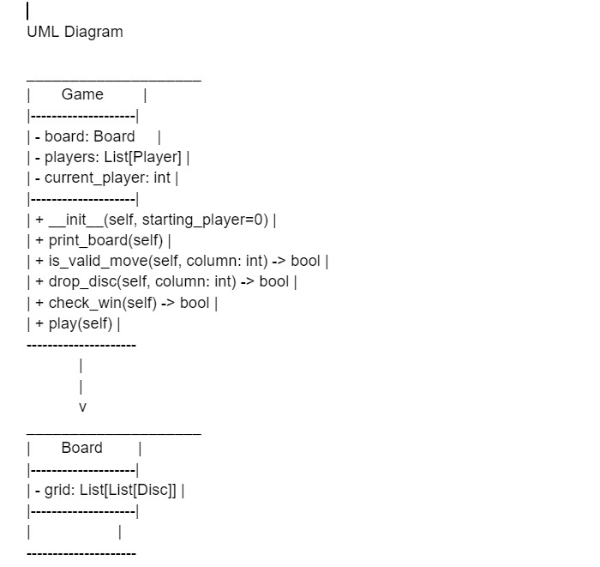
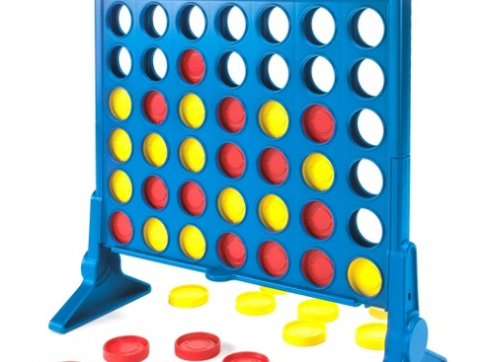
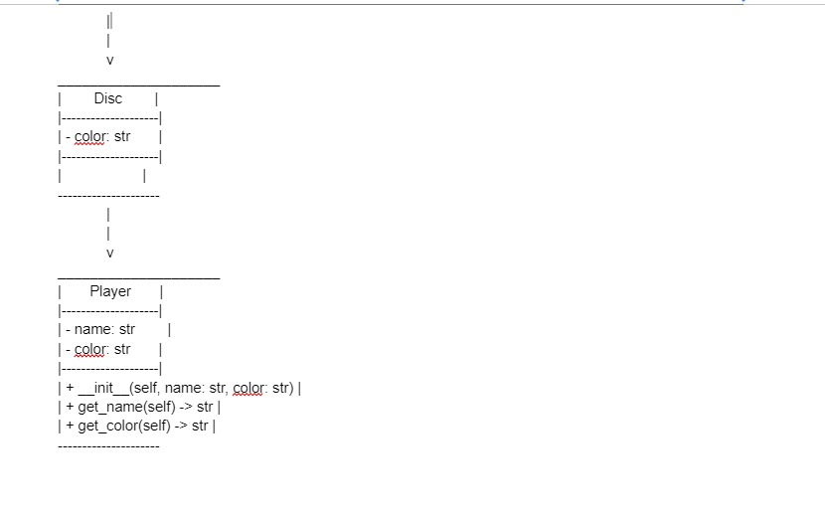
UML DIAGRAM
Monolithic Design
Advantages:
1.Straightforward implementation
2.Efficient for game requirements
3.Easier management

Slide 7
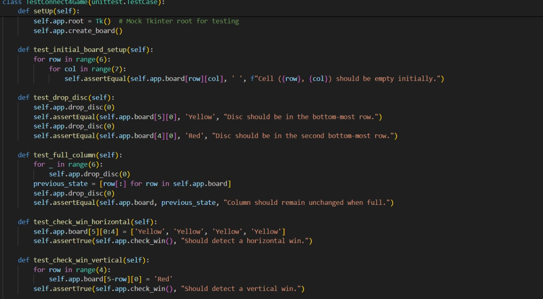
Testing
1.Black Box Testing:
Ensured the game functions correctly from the user's perspective.
Validated scenarios including valid/invalid moves, win conditions, and game resets.
2.GUI Testing:
Manually interacted with the user interface.
Confirmed appropriate responses to user actions.
3Unit Testing with Python:
Developed test cases for core methods.
Verified game logic and rule enforcement.
4. Combined Testing Methods:
Employed both manual and automated testing techniques.
Ensured game robustness and reliability.

Slide 8
Github Link with application code and report
Github link :
https://github.com/FuadBaghirzade/gamecrfdkm.git

Slide 9

Thanks for your attention

